Slide 1


Social Buzz

Slide 2


Today's agenda
Project recap
Problem
The Analytics team
Process
Insights
Summary

Slide 3

Social Buzz is a fast-growing tech unicorn that need to adapt quickly to its global scales. Accenture has begun a 3-month POC focusing on these tasks:
An audit od Social Buzz’s big data practice
Recommendations for a successful IPO
Analysis to find Social buzz;s top 5 most popular categories of content
Project Recap

Slide 4

Problem
Over 100000 posts per day
36500000 pieces of content per year!

Slide 5



Andrew Fleming
Chief Technical Architect
The Analytics team
Marcus Rompton
Senior Principle
Yash Soni
Data Analyst

Slide 6
Process
1
Data Understanding
2
Data Cleaning
Data Modelling
3
4
Data Analysis
5
Uncover Insights

Slide 7
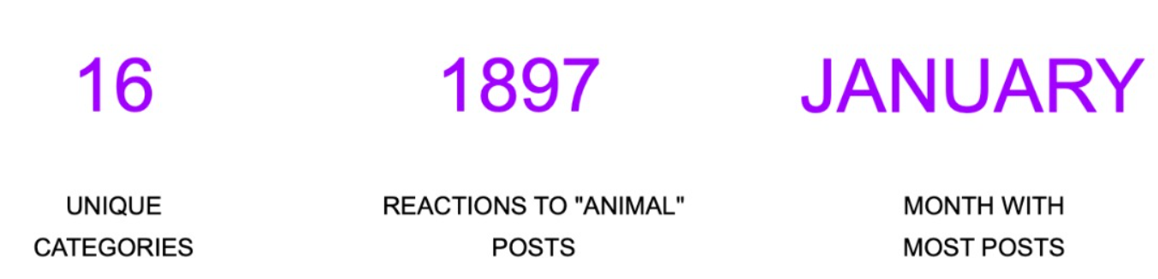

Insights

Slide 10
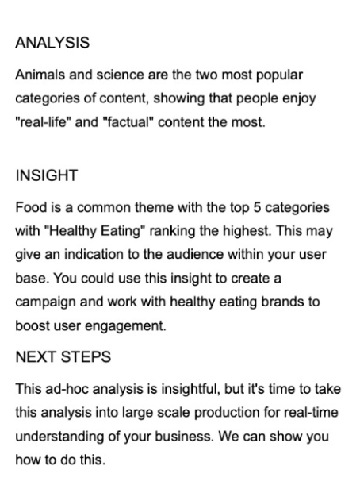

Summary

Slide 11
Thank you!
ANY QUESTIONS?

